Slide 1
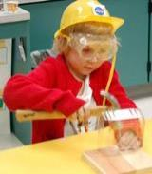
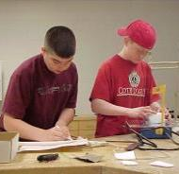
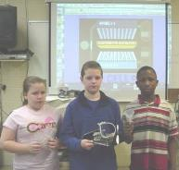

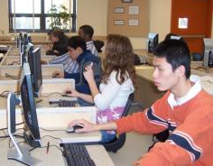

Advanced Design Applications Manufacturing
Teacher Resource Unit / Lesson Learning Cycle One
Learning Cycle Three – Looping Through Design
Notes:
TITLE SLIDE

Slide 2

The BIG Idea
Big Idea:
In this learning cycle, students will be focusing on applications of the engineering design model and a set of design principles that will guide their thinking as they solve technological problems. Knowledge of how manufacturing is shaped by these external factors will be essential for student success in the Manufacturing Unit Learning Cycles, Preliminary and Primary Challenges of the Advanced Design Applications course.
Notes:
[Authors: Please include teacher notes appropriately.]

Slide 3
Objectives
After completing this learning cycle, you will be able to:
Generate a variable solution to a technological problem using a design model (the engineering design process).
Identify and change a set of characteristics within a design as they pertain to a set of design principles and apply those concepts to the development of a product and a system.
Notes:
[Authors: Please include teacher notes appropriately.]

Slide 4
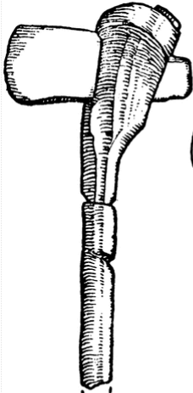
The Stone Age
Require thinking and planning to produce
Humans wants & needs have influenced technological developments.
Products must adapt to meet societal needs
Example:
Would you be willing to purchase the most advanced stereo produced in 1975? You probably would not be willing to buy a music player with an 8-track tape player.
Notes:
[These artifacts from the past (e.g., a stone axe) and modern products are forms of technology that require thinking and planning to produce. As the centuries have passed since the Stone Age, changing human wants and needs have influenced technological developments as well as the way things are made. Products must be adapted to meet the evolving demands of society in order to stay competitive. Would you be willing to purchase the most technologically advanced stereo produced in 1975? You probably would not be willing to purchase a stereo with an 8-track tape player. Products adapt and so do human desires and demands for products.

Slide 5
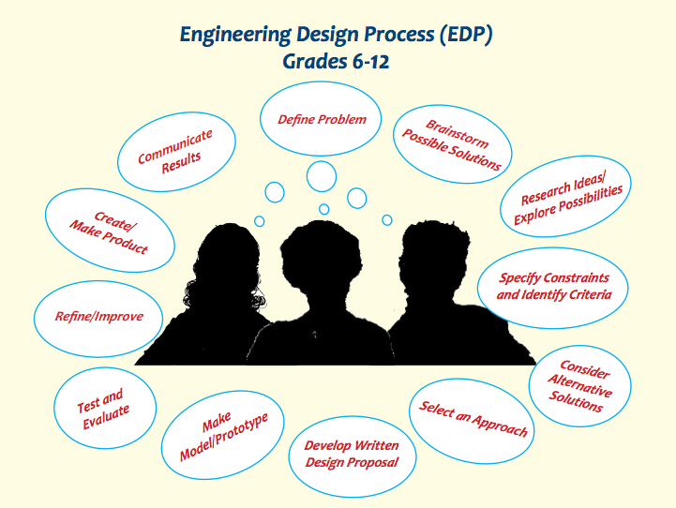
The Engineering Design Process
Notes:
The design loop is what designers use to guide their thinking while developing marketable and profitable products. Although it is used in many different variations, the strategy of using a design model or loop can help to reduce the chances of a faulty or inadequate product. The “loop” aspect of the design process will assure periodic feedback so that the product will continually be reevaluated and designed to meet the changing needs of the modern consumer. The design loop also helps designers solve problems in a logical and effective way by following a series of steps. Once a problem becomes apparent (through consumer feedback, defective parts, etc), the problem is clearly defined. In other workds, the complete nature of the problem is clarified and understood in order to create a complete solution.

Slide 6
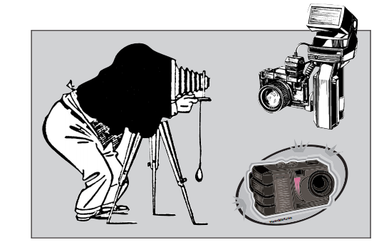
The Engineering Design Process
Parameters
Guide solution vary from project to project
Technical abilities
Available resources
Judgments, rules, standards to be met
Notes:
After the problem is identified, the parameters involved in solving the problem are established and outlined. The parameters that guide the solution vary from product to product. Usually the parameters concern technical abilities of the available resources’ for example, the type and amount of material available, the time constraints, the technical expertise needed, and the amount of money available often needs to be considered. Other parameters may include the judgments, rules and standards that need to be followed or met. For example, if a product needs to meet government standards for cleanliness, health or safety, those issues need to be considerer at this point in the design loop.

Slide 7
The Engineering Design Process
Brainstorming
Different solutions developed
Varied characteristics
Write every idea down
Research Ideas/Explore Possibilities
See if ideas already developed
Find what other solutions exist for problem.
Notes:
After the problem and the parameters are clarified, the next step is to begin brainstorming and to identify multiple potential solutions to the problem. A list of different solutions should be developed and the characteristics which can be varied to better meet the problem pinpointed.

Slide 8
The Engineering Design Process
Consider Alternative Solutions
Review research
Determine if alternate solutions work better
Select An Approach
Make a decision based on criteria and constraints
Must best meet the problem
Notes:
From the list, the solution that best meets both the problem and the parameters is chosen (or a solution created from combined and condensed ideas).

Slide 9
The Engineering Design Process
Develop Written Design Proposal
Justify why the chosen proposal best meets the needs of problem
Make sketches to show possible solution
Make a Model or Prototype
Use to communicate ideas
Construct from drawings
Notes:
Write up why the solution was chosen and justify the decision based on the criteria and constraints. Sketches should be made to determine what the prototype/model will look like. Then build the model/prototype based on the descriptions and pictures.

Slide 10
The Engineering Design Process
Test and Evaluate
Design experiments and test
Gather data to analyze
Critique for areas of concern
Decide on redesign
Refine/Improve
Modify or Rebuild prototype
Refine until accuracy is consistent
Determine if criteria of problem has been met.
Notes:
The selected solution is refined and fully developed and then tested and evaluated again. After the problem is believed to be solved, the item or product Is made and presented.

Slide 11
The Engineering Design Process
Create/Make Product
Decide on the type of production
Consider packaging of product
Communicate Results
Communicate final solution in write up.
Market product
Distribute
Notes:
If other problems or feedback concerning the product occur, the process starts over again.

Slide 12
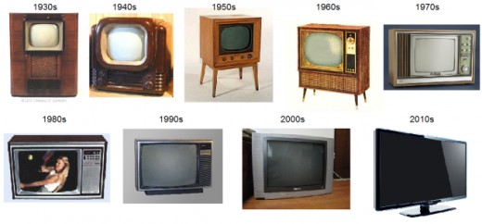
Product Evolution
Think about how the television has changed over the years. Why have these changes taken place?
From http://danida.hubpages.com/hub/The-4-Ways-Television-Has-Evolved
Notes:
An excellent example of a product “passing” through the design process many times is the television. Think about how the television has changed over the years. Why have these changes taken place? Perhaps consumers have demanded improved performance (plasma screens, curved screens), better usability (remote controls, voice control), or simply more attractive designs. Another possible reason could be that new technologies (satellites and digital cable) have impacted the over-all design. Regardless of the factors that “drive” the design changes in the television, a competitive marketplace requires adaptations and innovations in manufacturing.

Slide 13
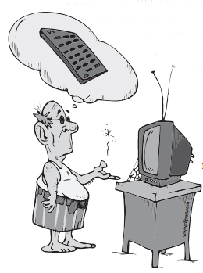
Product Evolution
Consider design of manufacturing process and facilities
Processes must change
New tools, materials and equipment
Notes:
Aside from the products themselves, it is equally important to consider the design of manufacturing processes and facilities. In order for a product to change, the processes and facilities. In order for a product to change, the processes by which it is produced must also change. New tools, materials, and equipment enable manufacturers to create improved products. The design process is used while designing any manufacturing facility or process as well as the product. An important component of maximizing a company’s profit is to reduce its production costs. Improvements made to the production or assembly of components can increase efficiency, limit or utilize waste more effectively, or provide new and innovative features to the products being manufactured.
THIS ENDS THE PRESENTATION. THE NEXT SLIDES ARE FOR THE EXPLORATION PART OF THE UNIT.

Slide 14

Exploration
What do people want and need?
Buying sunglasses
How to buy them?
What do you want and need?
How many to try on?
How many decisions need to be made before you buy a pair?
Notes:
So many options are available to consumers today when they go to the store to make a purchase. Product designers are always searching for new ways to discover what people want and need. What is it that you want in a product? How about when you buy a new pair of sunglasses? Is making such a purchase an easy task? How many decisions do you have to make before finding the “right pair” for you? Can you discuss the criteria that you would use to make that decision? Most likely, other people would have selected a different pair than the one you did. Perhaps they used different criteria in making their decision or maybe they are just interested in different design features than you are. Product design is influenced by factors such as how the product looks (form) and how well it does the job it is intended to do (functions). Ensuring that an item looks and feels good can be just as important as accomplishing its intended task when you are producing a product in a competitive market place.

Slide 15
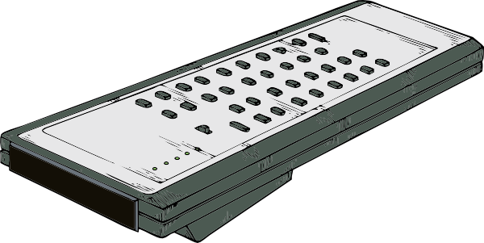
Exploration
Balance between design
Form vs. Function
Designed with needs in mind
http://4vector.com/free-vector/remote-control-clip-art-116313
Notes:
Sometimes designers face difficulties finding a balance between design characteristics that accomplished form while achieving functionality. Think about the modern remote control for a television. Most have been designed with buttons that are appealing and readable, and that are a size that is comfortable for the average user-but what about the ability to function? Consumers want an appealing device to operate their television equipment, but they also want everything to be universal and easy to use and understand.

Slide 16
Exploration
Looking at reasons to change design
Needs
User
Desires
http://4vector.com/free-vector/remote-control-clip-art-116313
Notes:
With all of the equipment and hardware that has become a part of the home entertainment center, the electronics designers struggle to create remote control technologies that are universal and require minimal effort to operate while meeting the wants and needs of the consumer. Is your remote control “easy” for you to operate? Think of an elderly friend or relative. Do you think that they have the same desires for a remote control device that you have?

Slide 17
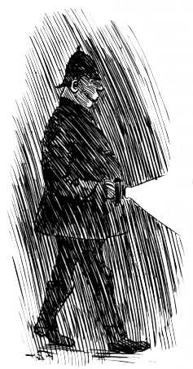
Flashlight Design
In this activity you are going to examine another product that has undergone tremendous changes in form and function. Your instructor has collected a variety of flashlights that range from very simple to very complex. Before looking at these flashlights, gather into small teams of two or three and complete the tasks.
Notes:
Ask your students probing questions that will cause them to think about design principles (i.e., function, efficiency, aesthetics, ergonomics, and anthropometrics) as they generate their own sets of questions. For example, ask you students to consider questions that would cause someone to thing about the function of a flashlight, or the ergonomics built into the designs they are working with.
Sample questions:
Does the flashlight use rechargeable batteries?
Does the flashlight adequately provide light in a darkened space?
Does the flashlight work without failure under various conditions (water, cold, heat)?
Is the flashlight attractive?
Is the flashlight comfortable to hold?
Is the size and shape of the flashlight consistent with what a flashlight should be?
Does the flashlight have the potential to attract the attention of prospective buyers?
After developing questions of this type, students should begin to assess each of the sample flashlights based on these questions to determine the one that best fits their needs as a consumer.

Slide 18
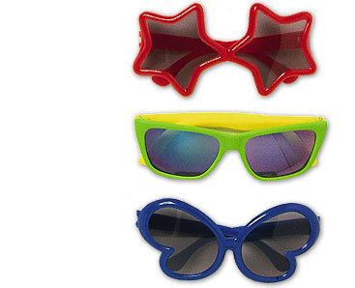

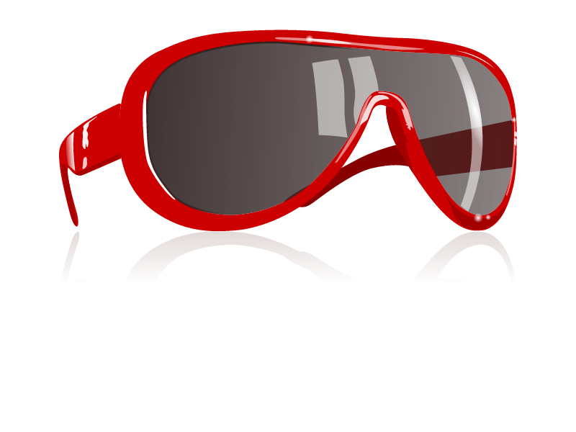
Function
The extent to which a device or process fulfills its intended purpose.
For example, sunglasses come in a variety of different styles, but they must be able to block ultraviolet rays and fit a human face.
http://www.clipartbest.com/sunglasses-clipart
Notes:
[Authors: Please include teacher notes appropriately.]

Slide 19

Efficiency
Ability to accomplish a purpose or function with minimal resources (e.g., time, energy, effort). For example, a portable music player should be able to maximize its power supply so that recharging is minimized. Automation can also benefit the efficiency rating of almost any manufacturing process.
http://www.clipartbest.com/clipart-9Tzr7p8TE
Notes:
[Authors: Please include teacher notes appropriately.]

Slide 20
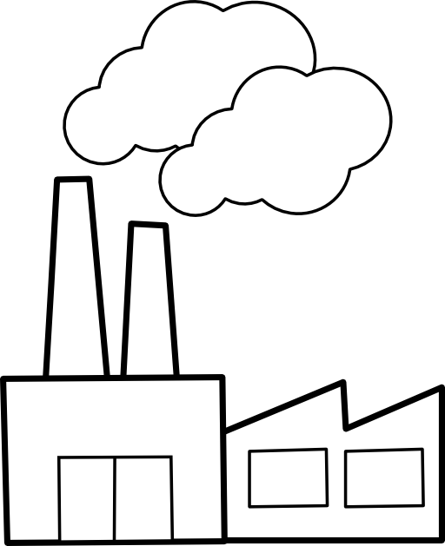
Aesthetics
The concern here is for visual appeal. Clothing designers compete to create the most attractive clothing that will appeal to consumers and fashion retailers.
Aesthetics can even be important for facilities. Small manufacturers that compete to supply a larger manufacturer with a component or product need to make sure their facilities are neat, clean, and well organized if they hope to attract business and retain employees.
http://www.clipartbest.com/clipart-9Tzr7p8TE
Notes:
[Authors: Please include teacher notes appropriately.]

Slide 21
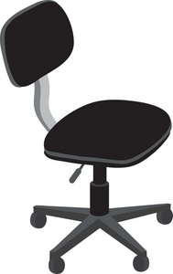
Ergonomics
The efficiency and safety of human in their working environments. Ergonomics involve careful consideration of interactions between the human body and the physical world or between humans and the devices that they use.
For example, the design of a chair should account for the natural curvature of the back. When humans are involved with manufacturing, the operation of machines should be designed to minimize any unnecessary physical strain or tension.
http://www.furnitureclipart.com/free_furniture_clipart/clip_art_illustration_of_a_black_office_chair_0071-0908-1917-4016.html
Notes:
[Authors: Please include teacher notes appropriately.]

Slide 22
Anthropometrics
Standards and requirements that allow the product to fit the human spectrum or condition.
A contemporary term that has applied to products and systems for a very long time.
For example, a baby crib must have specific widths between slats to ensure safety.
Specific requirements for products help to ensure safety, reliability, and in some cases quality.
http://www.furnitureclipart.com/free_furniture_clipart/clip_art_illustration_of_a_black_office_chair_0071-0908-1917-4016.html
Notes:
The size and shape of electrical plugs must be designed according to standards to ensure that they can function in a standard outlet.
The use of materials is also an important part of anthropometrics.
Most of the tools and machines in manufacturing facilities have been designed according to a set of standards to insure interchangeability of components in the event of a breakdown or upgrade.

